Slide 1




THE
FAST
FUNCTIONAL
AND THE
C# 7.1
Alejandro Campos Magencio
@alejacma
Technical Evangelist
Notes:
The Fast & the Functional: C# 7
http://www.lambda.world/schedule/#session-107
C# is a multi-paradigm programming language that supports lambda expressions since the year 2007, and more and more functional programming characteristics have been added to it during the past 10 years. Now I present you C#7, a new version of the language which includes even more functional goodness. Join me on this workshop and discover what C# has to offer.
About Alejandro Campos
Alejandro Campos Magencio has been a developer for over 20 years, still enjoying it, always learning and sharing what he learns. He currently works as a Technical Evangelist specialized in Development with Microsoft Technologies.
Functional Programming
http://en.wikipedia.org/wiki/Functional_programming
“
In computer science, functional programming is a programming paradigm that treats computation as the evaluation of mathematical functions and avoids state and mutable data. It emphasizes the application of functions, in contrast to the imperative programming style, which emphasizes changes in state.
“

Slide 2

It’s been a long but rewarding road
2002 | C# 1.0 .NET 1.0 & VS 2002 | First-class functions (delegates) from named methods
2003 | C# 1.2 .NET 1.1 & VS 2003
2005 | C# 2.0 .NET 2.0 & VS 2005 | Generics, Anonymous methods, Nullable types, Co- & Contra-variance for delegates, Iterators
2007 | C# 3.0 .NET 3.5 & VS 2008 | Lambda Expressions, Extension methods, Expression trees Anonymous types, Implicit typing (var), Query expressions
2010 | C# 4.0 .NET 4.0 & VS 2010 | Late binding (Dynamic), Delegate and interface generic variance
2012 | C# 5.0 .NET 4.5 & VS 2012 | Async programming
2015 | C# 6.0 .NET 4.6 & VS 2015 | Compiler-as-a-service (Roslyn), Auto property initializers, Expression-bodied members, Null propagator
2017 | C# 7.0 .NET 4.7 & VS 2017 | Tuples, Pattern Matching, Local Functions
2017 | C# 7.1 .NET 4.7.1 & VS 2017 v15.3 | Async Main, better type inference
Notes:
What are the correct version numbers for C#?
http://stackoverflow.com/questions/247621/what-are-the-correct-version-numbers-for-c
“
C# 1.0 released with .NET 1.0 and VS2002 (January 2002)
C# 1.2 (bizarrely enough); released with .NET 1.1 and VS2003 (April 2003). First version to call Dispose on IEnumerators which implemented IDisposable. A few other small features.
C# 2.0 released with .NET 2.0 and VS2005 (November 2005). Major new features: generics, anonymous methods, nullable types, iterator blocks
C# 3.0 released with .NET 3.5 and VS2008 (November 2007). Major new features: lambda expressions, extension methods, expression trees, anonymous types, implicit typing (var), query expressions
C# 4.0 released with .NET 4 and VS2010 (April 2010). Major new features: late binding (dynamic), delegate and interface generic variance, more COM support, named arguments and optional parameters
C# 5.0 released with .NET 4.5 and VS2012 (August 2012). Major features: async programming, caller info attributes. Breaking change: loop variable closure.
C# 6.0 released with .NET 4.6 and VS2015 (July 2015). Implemented by Roslyn. Features: initializers for automatically implemented properties, using directives to import static members, exception filters, binary literals and digit separators, indexed members and element initializers, await in catch and finally, extension Add methods in collection initializers.
C# 1.0 with Visual Studio.NET
C# 2.0 with Visual Studio 2005
C# 3.0 with Visual Studio 2008
C# 4.0 with Visual Studio 2010
C# 5.0 with Visual Studio 2012
C# 6.0 with Visual Studio 2015
“
C Sharp (programming language)
https://en.wikipedia.org/wiki/C_Sharp_(programming_language)
“
Functional programming
Though primarily an imperative language, C# 2.0 offered limited support for functional programming through first-class functions and closures in the form of anonymous delegates. C# 3.0 expanded support for functional programming with the introduction of a light weight syntax for lambda expressions, extension methods (an affordance for modules), and a list comprehension syntax in the form of a "query comprehension" language.
“
Why is C# a functional programmming language?
http://stackoverflow.com/questions/393757/why-is-c-sharp-a-functional-programmming-language
“
C# has borrowed a lot of features from ML and Haskell for example:
C# 2.0 brought us parametric polymorphism (or "generics"). I've heard that Dom Syme, one of the creators of F#, was largely responsible for implementing generics in the .NET BCL.
C# 2.0 also allows programmers to pass and returns functions as values for higher-order functions, and has limited support for anonymous delegates.
C# 3.0 and 3.5 improved support anonymous functions for true closures.
LINQ can be considered C#'s own flavor of list comprehensions.
Anonymous types look like an approximation of ML records
Type-inference is a given.
I don't know about you, but C# extension methods look an awful lot like Haskell type classes.
There's been a lot of talk about the "dynamic" keyword in C# 4.0. I'm not 100% sure of its implementation details, but I'm fairly sure its going to use structural typing rather than late binding to retain C#'s compile time safety. Structural typing is roughly equivalent to "duck typing for static languages", its a feature that Haskell and ML hackers have been enjoying for years.
This isn't to say that C# is a functional programming language. Its still missing important features such as pattern matching, tail-call optimization, and list and tuple literals. Additionally, idiomatic C# is fundamentally imperative with a heavy dependence on mutable state.
I wouldn't necessarily consider some of those features mentioned above as exclusive to functional programming languages, but its pretty clear that the C# developers have taken a lot of inspiration from functional programming languages in the past few years.
“
C# is a functional programming language
http://sneezy.cs.nott.ac.uk/fun/nov-06/FunPm.ppt
What's new in C# 7
https://docs.microsoft.com/en-us/dotnet/csharp/whats-new/csharp-7
New Features in C# 7.0
https://blogs.msdn.microsoft.com/dotnet/2017/03/09/new-features-in-c-7-0/
“
Out variables → https://github.com/dotnet/roslyn/blob/master/docs/features/outvar.md
Pattern matching, Is-expressions and Switch statements with patterns → https://github.com/dotnet/roslyn/blob/master/docs/features/patterns.md; https://docs.microsoft.com/en-us/dotnet/csharp/pattern-matching; https://docs.microsoft.com/en-us/dotnet/csharp/language-reference/keywords/is; https://docs.microsoft.com/en-us/dotnet/csharp/language-reference/keywords/switch
Tuples → https://github.com/dotnet/roslyn/blob/master/docs/features/tuples.md
Deconstruction → https://github.com/dotnet/roslyn/blob/master/docs/features/deconstruction.md
Local Functions → https://github.com/dotnet/roslyn/blob/master/docs/features/local-functions.md
Literal improvements
Ref returns and locals
Generalized async return types → https://github.com/dotnet/roslyn/blob/master/docs/features/task-types.md
More expression bodied members → https://docs.microsoft.com/en-us/dotnet/csharp/programming-guide/statements-expressions-operators/expression-bodied-members
Throw expressions → https://github.com/dotnet/roslyn/blob/master/docs/features/throwexpr.md
“
What's new in C# 7.1
https://docs.microsoft.com/en-us/dotnet/csharp/whats-new/csharp-7-1
“
The C# compiler supports C# 7.1 starting with Visual Studio 2017 version 15.3, or the .NET Core SDK 2.0. However, the 7.1 features are turned off by default.
Async main → https://docs.microsoft.com/en-us/dotnet/csharp/whats-new/csharp-7-1#async-main
Default literal expressions → https://docs.microsoft.com/en-us/dotnet/csharp/whats-new/csharp-7-1#default-literal-expressions
Inferred tuple element names → https://docs.microsoft.com/en-us/dotnet/csharp/whats-new/csharp-7-1#inferred-tuple-element-names
“
Visual Studio 2017 Release Notes
https://www.visualstudio.com/en-us/news/releasenotes/vs2017-relnotes
C# Language Proposals
https://github.com/dotnet/csharplang/tree/master/proposals
https://github.com/dotnet/csharplang/tree/master/proposals/csharp-7.2

Slide 3

FIRST-CLASS
FUNCTIONS
IN
C#
Notes:
Functional-style programs pass functions around as first-class values. In C#, methods can be values.
Functional Programming in C#
http://www.codeproject.com/Articles/375166/Functional-programming-in-Csharp
“
Functions as first-class values
The base concept in functional programming is functions. In functional programming we need to create functions as any other objects, manipulate them, pass them to other functions, etc. Therefore we need more freedom because functions are not just parts of classes - they should be independent objects. In C# you can use a function object as any other object type. In the following sections, you can see how we can define function types, assign values to function objects (references), and create complex functions.
“
Overview: Programming with Expressions
https://msdn.microsoft.com/en-us/library/vstudio/hh297104(v=vs.100).aspx
“
In functional languages, the state is represented by what a function returns and the only way to modify a state is to return a new value. Following this logic, in functional languages, everything is interpreted as an expression with some return value.
Programs written as expressions provide a new way of thinking about their execution.
Functional programmers use an approach called computation by calculation. The idea behind computation by calculation is to start with the original expression (such as a function call) and perform a single step (like replacing the call with the body of the function or calculating the result of a primitive mathematical operation). By repeating this step several times, you can easily analyze how the program evaluates.
“
Overview: Understanding Functional Types
https://msdn.microsoft.com/en-us/library/vstudio/hh297103(v=vs.100).aspx
“
the most interesting compound type in functional programming is a function.
functional languages treat functions in the same way as other types.
“
Refactoring Into Pure Functions
https://msdn.microsoft.com/en-us/library/bb669139.aspx
“
a pure function has two useful characteristics:
It has no side effects. The function does not change any variables or the data of any type outside of the function.
It is consistent. Given the same set of input data, it will always return the same output value.
“

Slide 4
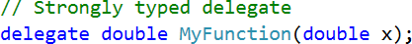
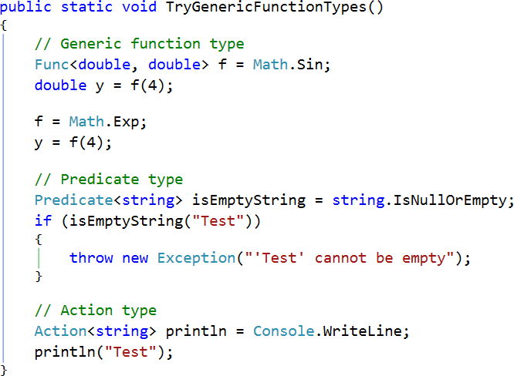
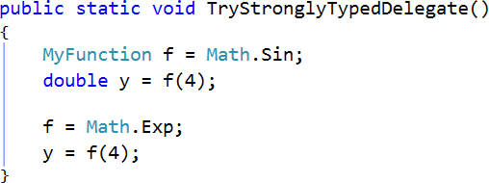
Function Types
Notes:
Functional Programming in C#
http://www.codeproject.com/Articles/375166/Functional-programming-in-Csharp
Overview: Understanding Functional Types
https://msdn.microsoft.com/en-us/library/vstudio/hh297103(v=vs.100).aspx
“
Functions and tuples can easily be represented in C#. Functions roughly correspond to delegates (e.g., Func<int, string>) and tuples are available in .NET 4.0 and you can use them from C# (e.g., Tuple<string, int>).
“
Comparison<T> Delegate
https://msdn.microsoft.com/en-us/library/tfakywbh.aspx
Converter<TInput, TOutput> Delegate
https://msdn.microsoft.com/en-us/library/kt456a2y.aspx

Slide 5
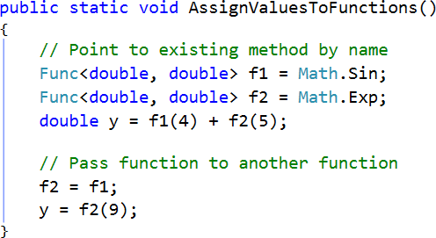
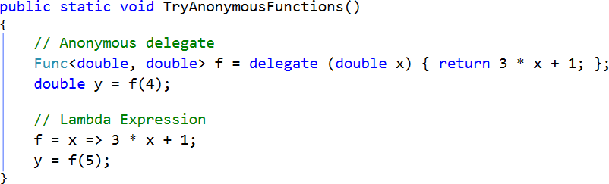
Function Values
Notes:
Functional Programming in C#
http://www.codeproject.com/Articles/375166/Functional-programming-in-Csharp

Slide 6
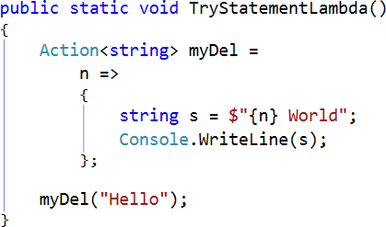
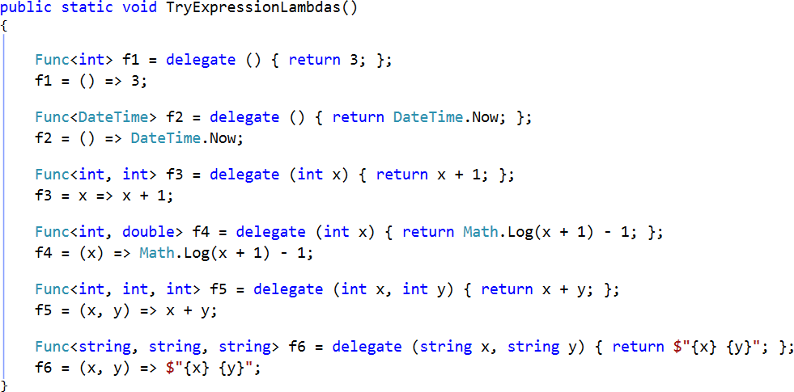
Lambda Expressions
Notes:
Lambda Expressions (C# Programming Guide)
http://msdn.microsoft.com/en-us/library/bb397687.aspx

Slide 7
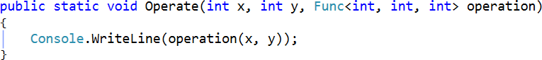
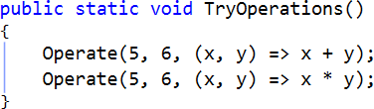
Functions as Parameters
Notes:
Lambda Expressions (C# Programming Guide)
http://msdn.microsoft.com/en-us/library/bb397687.aspx

Slide 8
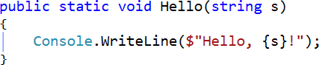
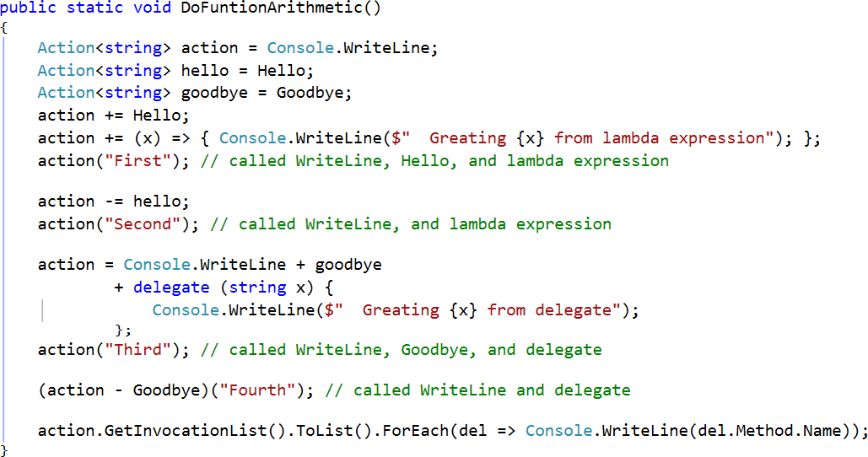
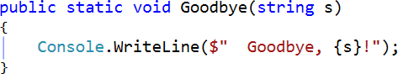
Function Arithmetic
Notes:
Multicast-delegates
Functional Programming in C#
http://www.codeproject.com/Articles/375166/Functional-programming-in-Csharp

Slide 9
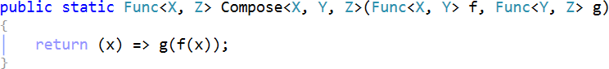
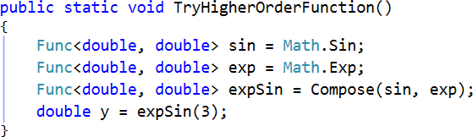
Higher Order Functions
Notes:
Functions that handle other functions are called higher order functions
Functional Programming in C#
http://www.codeproject.com/Articles/375166/Functional-programming-in-Csharp

Slide 10
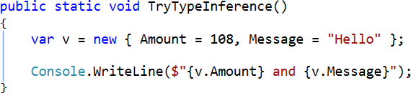
Type Inference & Anonymous Types
Notes:
Anonymous Types (C# Programming Guide)
http://msdn.microsoft.com/en-us/library/bb397696.aspx
Overview: Understanding Functional Types
https://msdn.microsoft.com/en-us/library/vstudio/hh297103(v=vs.100).aspx
“
F# is a statically typed language, where every expression has a type… types don't have to be written explicitly in F#
“

Slide 11
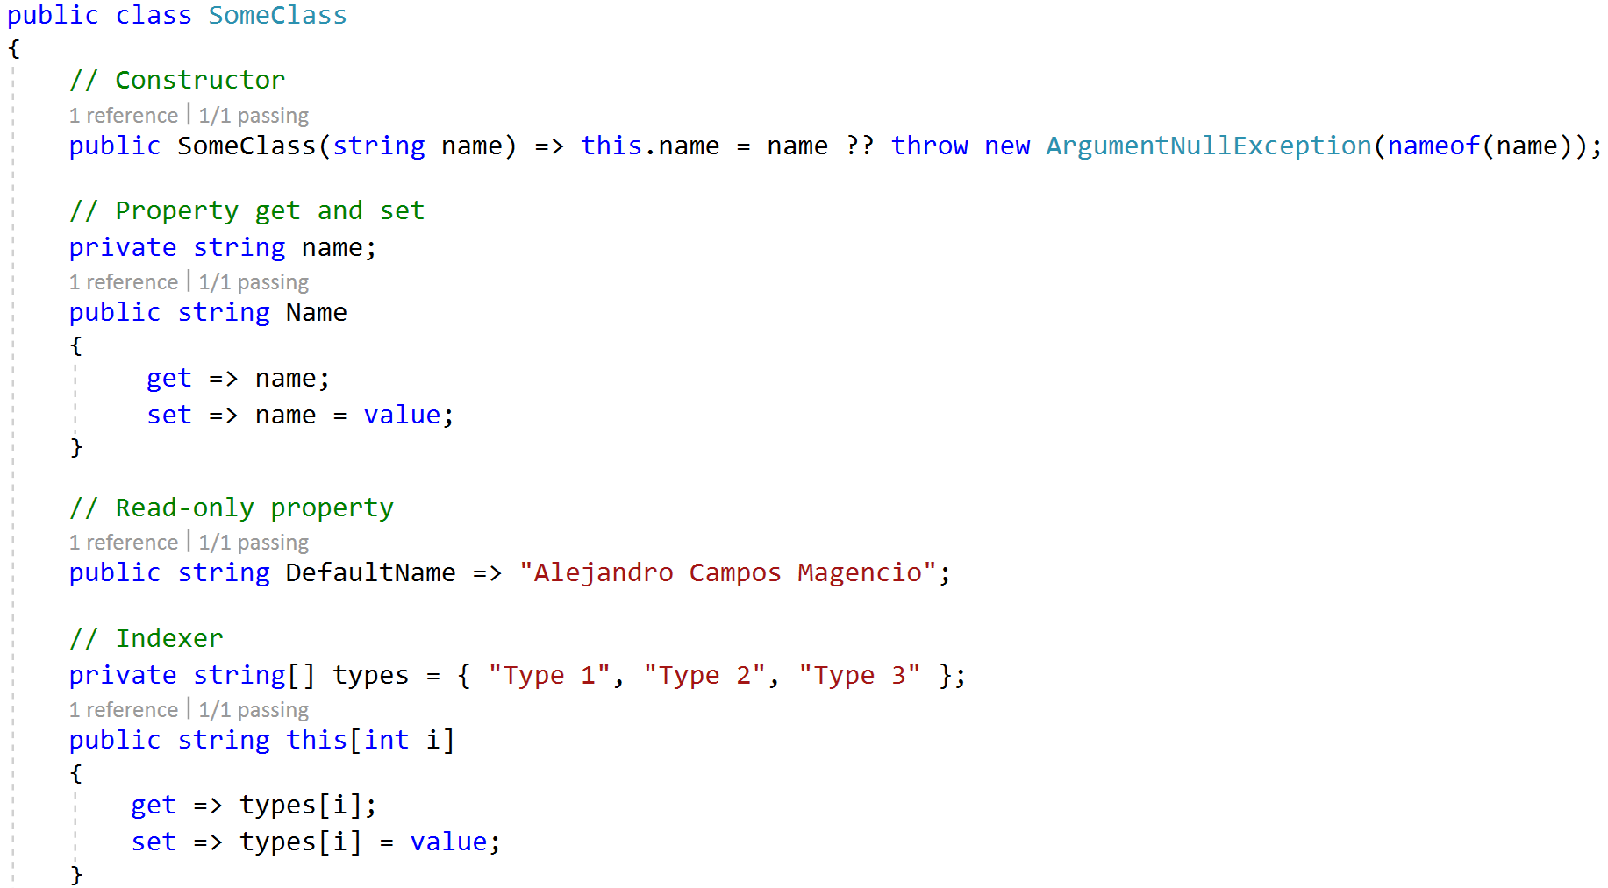
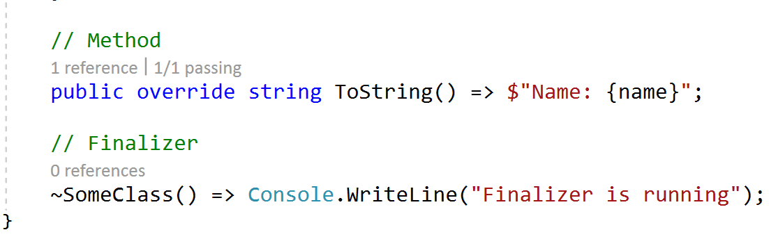
Expression-bodied Members
Throw Expression
Notes:
Expression-bodied members (C# programming guide)
https://docs.microsoft.com/en-us/dotnet/csharp/programming-guide/statements-expressions-operators/expression-bodied-members
Throw expressions
https://github.com/dotnet/roslyn/blob/master/docs/features/throwexpr.md

Slide 12
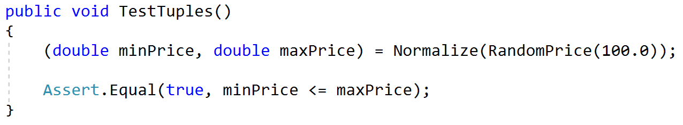
Immutable Types: Tuples
Notes:
Tuples
https://github.com/dotnet/roslyn/blob/master/docs/features/tuples.md
Overview: Working with Immutable Data
https://msdn.microsoft.com/en-us/library/vstudio/hh297115(v=vs.100).aspx
“
Immutability is one of the key concepts in functional programming.
The approach to using immutable values isn’t limited just to variables but extends to declarations of all functional data types
“
Overview: Understanding What a Program Does
https://msdn.microsoft.com/en-us/library/vstudio/hh297110(v=vs.100).aspx
“
String is probably the best-known immutable type in the .NET world, but there are many examples, such as DateTime and other value types.
A field in C# can be explicitly marked as immutable using the readonly keyword. Even when a field is immutable, the target object can be mutated if the field is a reference to a class that’s not immutable. A truly immutable class needs to have all fields marked as readonly and the types of these fields must be primitive types, value types, or other immutable classes.
Implementing a truly immutable type in C# is somewhat cumbersome. It is not possible to use automatically implemented properties (because they always create a field that is not readonly) and all values have to be initialized in a constructor.
An important property of functional code is that the only thing a method can do is to return some values or objects as the result. It cannot modify the state of the object and it cannot change any global states because all objects are immutable. This greatly simplifies testing. A unit test only needs to check that a method returned the right result and it doesn’t need to worry about the rest of the world.
“
Tutorial: Functional Programming in C# and F#
https://msdn.microsoft.com/en-us/library/vstudio/hh297108%28v=vs.100%29.aspx#dfg
“
One of the properties of functional programs is that they work with immutable data structures.
“
Step 1: Working with Tuples
https://msdn.microsoft.com/en-us/library/vstudio/hh297117(v=vs.100).aspx
“
A tuple is probably the simplest immutable data structure you can imagine. It is a type that groups together several values of (possibly) different types. Tuples are immutable, which means that the values stored in a tuple cannot be changed (unless they are themselves mutable) once a tuple is created. However, tuples can be passed around to other functions and new tuples can be created from the values stored in the original ones. The examples of using this simple type show how functional programming works in general.
“
Overview: Understanding Functional Types
https://msdn.microsoft.com/en-us/library/vstudio/hh297103(v=vs.100).aspx
“
Tuple types can be used to group multiple values of different types into a single value. In functional languages, code is written as an expression that returns a result. What if an expression needs to return two values, for example, the name and the price of a product? The simplest option to group values is to use a tuple.
Functions and tuples can easily be represented in C#. Functions roughly correspond to delegates (e.g., Func<int, string>) and tuples are available in .NET 4.0 and you can use them from C# (e.g., Tuple<string, int>).
“
Step 2: Working with Functional Lists
https://msdn.microsoft.com/en-us/library/vstudio/hh297099(v=vs.100).aspx
“
Functional lists are a recursive data structure.
Lists can be decomposed using pattern matching.
Pattern matching is a natural construct in functional languages, but there’s no corresponding feature in C#.
“

Slide 13
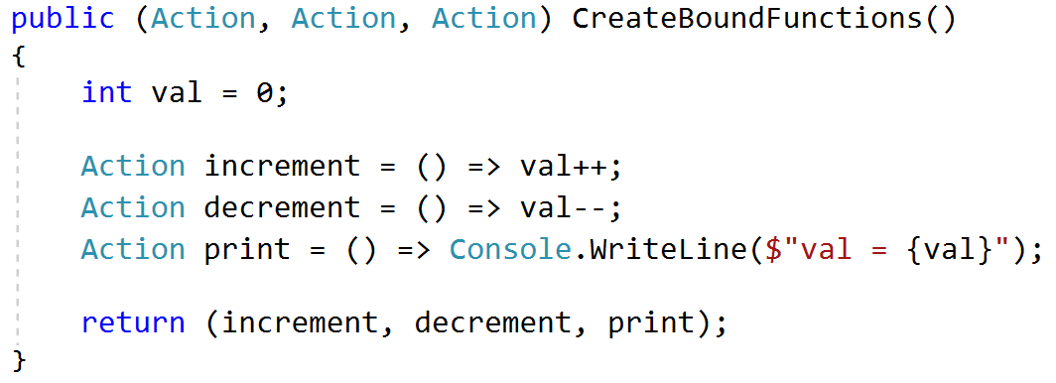
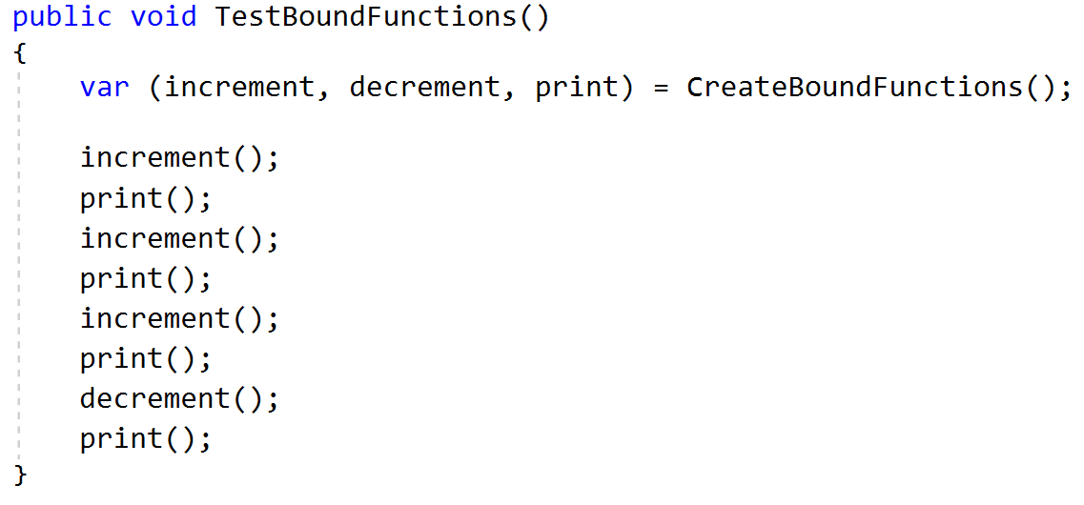
Closures
Notes:
Lambda Expressions (C# Programming Guide) -> Variable Scope in Lambda Expressions
http://msdn.microsoft.com/en-us/library/bb397687.aspx
Functional Programming in C#
http://www.codeproject.com/Articles/375166/Functional-programming-in-Csharp
Closure (computer programming)
https://en.wikipedia.org/wiki/Closure_(computer_programming)
“
In programming languages, closures (also lexical closures or function closures) are a technique for implementing lexically scoped name binding in languages with first-class functions. Operationally, a closure is a record storing a function^{[a]} together with an environment:^{[1]} a mapping associating each free variable of the function (variables that are used locally, but defined in an enclosing scope) with the value or storage location to which the name was bound when the closure was created.^{[b]} A closure—unlike a plain function—allows the function to access those captured variables through the closure's reference to them, even when the function is invoked outside their scope.
“

Slide 14
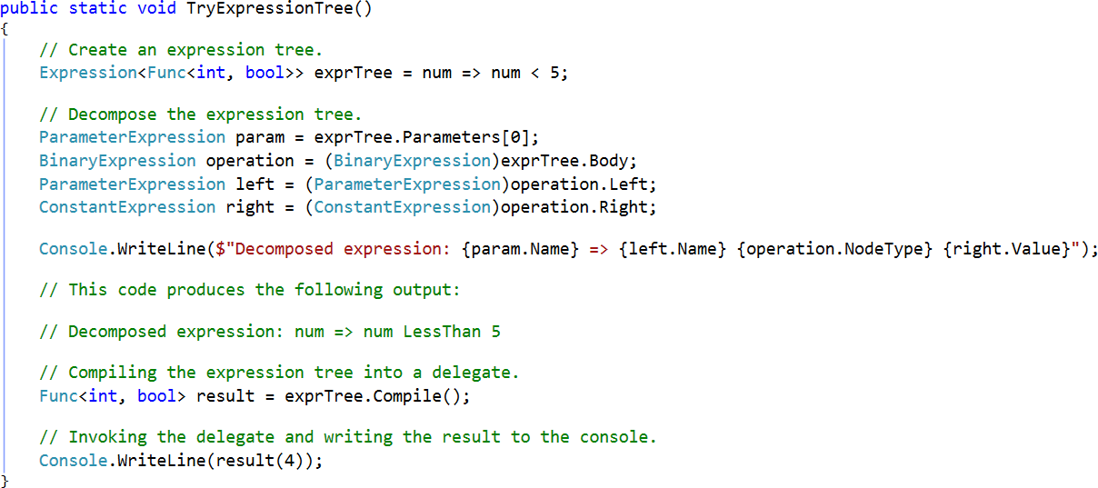
Expression Trees
Notes:
This enables dynamic modification of executable code, the execution of LINQ queries in various databases, and the creation of dynamic queries
Expression Trees
https://msdn.microsoft.com/en-us/library/bb397951.aspx

Slide 15
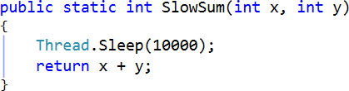
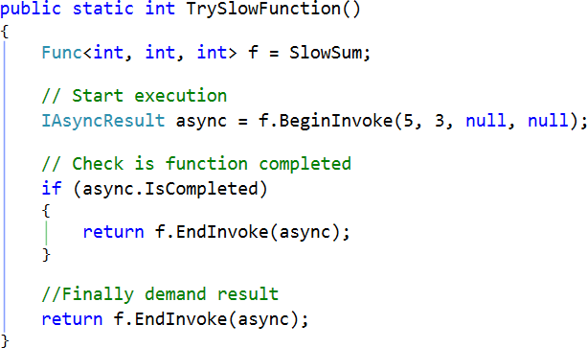
Async Functions
Notes:
Delegate.BeginInvoke is not supported by .NET Core 2.0
Functional Programming in C#
http://www.codeproject.com/Articles/375166/Functional-programming-in-Csharp

Slide 16
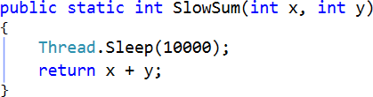
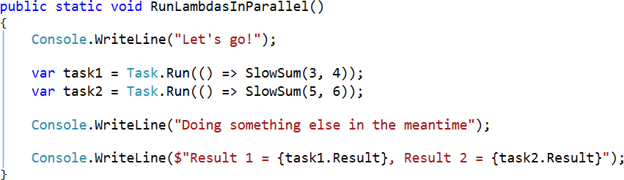
Task Parallel Library (TPL)
Notes:
Overview: Parallel and Asynchronous Programming
https://msdn.microsoft.com/en-us/library/vstudio/hh297123(v=vs.100).aspx
“
Task Parallel Library (TPL) and Parallel LINQ (PLINQ)
“
Parallel Programming in the .NET Framework
https://msdn.microsoft.com/en-us/library/dd460693(v=vs.110).aspx
Task Parallel Library (TPL)
https://msdn.microsoft.com/en-us/library/dd460717(v=vs.110).aspx

Slide 17
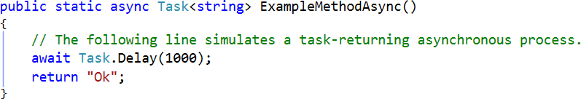
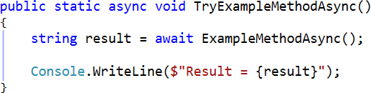
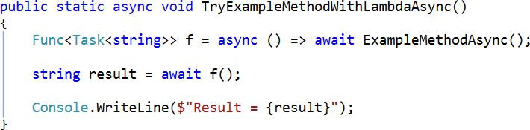
Async Lambdas
Notes:
Lambda Expressions (C# Programming Guide)
http://msdn.microsoft.com/en-us/library/bb397687.aspx
Asynchronous Programming with Async and Await (C# and Visual Basic)
http://msdn.microsoft.com/en-us/library/hh191443.aspx

Slide 18
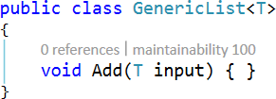
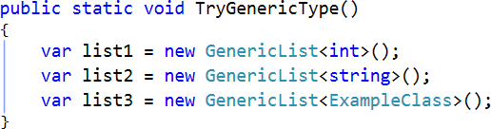
Generics
Type Inference
Notes:
Generics (C# Programming Guide)
http://msdn.microsoft.com/en-us/library/512aeb7t.aspx
Collections (C# and Visual Basic)
http://msdn.microsoft.com/en-us/library/ybcx56wz.aspx

Slide 19
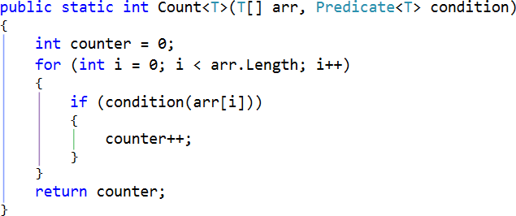
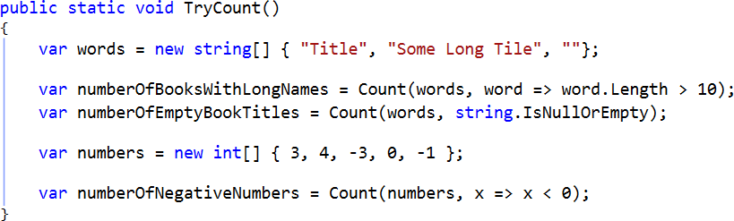
Generic Methods
Notes:
Generics (C# Programming Guide)
http://msdn.microsoft.com/en-us/library/512aeb7t.aspx
Functional programming in C#
http://www.codeproject.com/Articles/375166/Functional-programming-in-Csharp

Slide 20
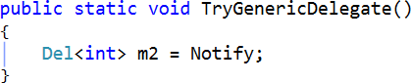
Generic Delegates
Notes:
Generic Delegates (C# Programming Guide)
https://msdn.microsoft.com/en-us/library/sx2bwtw7.aspx

Slide 21
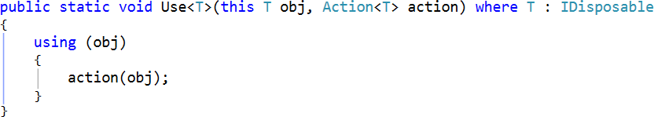
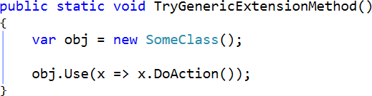
Extension Methods
Notes:
Functional Programming in C#
http://www.codeproject.com/Articles/375166/Functional-programming-in-Csharp

Slide 22
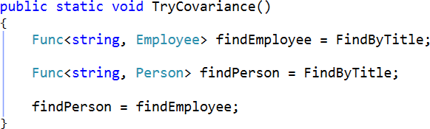
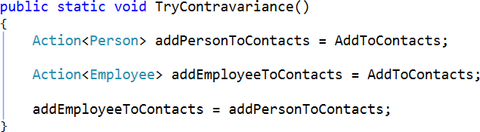
Covariance & Contravariance
Notes:
Covariance and Contravariance FAQ
http://blogs.msdn.com/b/csharpfaq/archive/2010/02/16/covariance-and-contravariance-faq.aspx
“
In C#, covariance and contravariance enable implicit reference conversion for array types, delegate types, and generic type arguments. Covariance preserves assignment compatibility and contravariance reverses it.
In C#, variance is supported in the following scenarios:
Covariance in arrays (since C# 1.0)
Covariance and contravariance in delegates, also known as “method group variance” (since C# 2.0)
Variance for generic type parameters in interfaces and delegates (since C# 4.0)
“
Using Variance in Delegates (C# and Visual Basic)
https://msdn.microsoft.com/en-us/library/ms173174.aspx
Variance in Delegates (C# and Visual Basic)
https://msdn.microsoft.com/en-us/library/dd233060.aspx
“
NET Framework 3.5 and Visual Studio 2008 introduced variance support for matching method signatures with delegate types in all delegates in C# and Visual Basic. This means that you can assign to delegates not only methods that have matching signatures, but also methods that return more derived types (covariance) or that accept parameters that have less derived types (contravariance) than that specified by the delegate type. This includes both generic and non-generic delegates.
In .NET Framework 4, you can enable implicit conversion between delegates, so that generic delegates that have different types specified by generic type parameters can be assigned to each other, if the types are inherited from each other as required by variance.
To enable implicit conversion, you must explicitly declare generic parameters in a delegate as covariant or contravariant by using the in or out keyword.
“
Using Variance for Func and Action Generic Delegates (C# and Visual Basic)
https://msdn.microsoft.com/en-us/library/dd465122.aspx

Slide 23
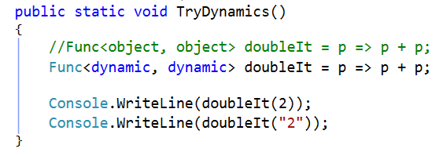
Dynamics
Notes:
dynamic (C# Reference)
https://msdn.microsoft.com/en-us/library/dd264741.aspx
“
dynamic exists only at compile time, not at run time.
The dynamic language runtime (DLR) is a new API in .NET Framework 4. It provides the infrastructure that supports the dynamic type in C#, and also the implementation of dynamic programming languages such as IronPython and IronRuby.
“
Dynamic Language Runtime Overview
https://msdn.microsoft.com/en-us/library/dd233052.aspx
“
The dynamic language runtime (DLR) is a runtime environment that adds a set of services for dynamic languages to the common language runtime (CLR). The DLR makes it easier to develop dynamic languages to run on the .NET Framework and to add dynamic features to statically typed languages.
Dynamic languages can identify the type of an object at run time, whereas in statically typed languages such as C# and Visual Basic (when you use Option Explicit On) you must specify object types at design time. Examples of dynamic languages are Lisp, Smalltalk, JavaScript, PHP, Ruby, Python, ColdFusion, Lua, Cobra, and Groovy.
Examples of languages developed by using the DLR include the following:
IronPython. Available as open-source software from the CodePlex Web site.
IronRuby. Available as open-source software from the RubyForge Web site.
“
Cutting Edge - Using the Dynamic Keyword in C# 4.0
https://msdn.microsoft.com/en-us/magazine/ee336309.aspx

Slide 24
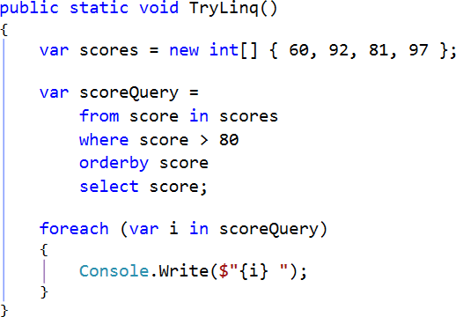
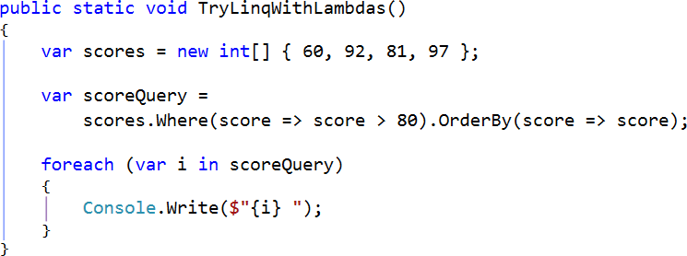
LINQ (Language-Integrated Query)
List comprehension syntax in the form of a "query comprehension" language
Type Inference
Notes:
LINQ (Language-Integrated Query)
http://msdn.microsoft.com/en-us/library/bb397926.aspx
LINQ Query Expressions (C# Programming Guide)
http://msdn.microsoft.com/en-us/library/bb397676.aspx

Slide 25
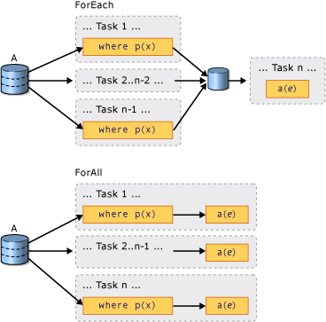
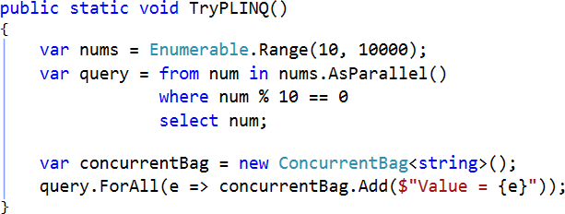
Parallel LINQ (PLINQ)
Notes:
Overview: Parallel and Asynchronous Programming
https://msdn.microsoft.com/en-us/library/vstudio/hh297123(v=vs.100).aspx
“
Task Parallel Library (TPL) and Parallel LINQ (PLINQ)
“
Parallel Programming in the .NET Framework
https://msdn.microsoft.com/en-us/library/dd460693(v=vs.110).aspx
Introduction to PLINQ
https://msdn.microsoft.com/en-us/library/dd997425(v=vs.110).aspx
“
PLINQ queries, just like sequential LINQ queries, operate on any in-memory IEnumerable or IEnumerable<T> data source, and have deferred execution, which means they do not begin executing until the query is enumerated. The primary difference is that PLINQ attempts to make full use of all the processors on the system. It does this by partitioning the data source into segments, and then executing the query on each segment on separate worker threads in parallel on multiple processors. In many cases, parallel execution means that the query runs significantly faster.
“

Slide 26
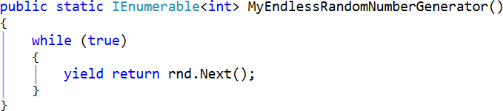
Lazy Listings with Iterators
Notes:
C# is a functional programming language
http://sneezy.cs.nott.ac.uk/fun/nov-06/FunPm.ppt
“
C# 2.0 introduces iterators, easing task of implementing IEnumerable e.g. static IEnumerable<int> UpAndDown(int bottom, int top) { for (int i = bottom; i < top; i++) { yield return i; } for (int j = top; j >= bottom; j--) { yield return j; } }
Iterators can mimic functional-style streams. They can be infinite:
static IEnumerable<int> Evens() { for (int i = 0; true; i += 2) { yield return i; } }
The System.Query library provides higher-order functions on IEnumerable<T> for map, filter, fold, append, drop, take, etc.
static IEnumerable<T> Drop(IEnumerable<T> xs, int n) { foreach(T x in xs) { if (n>0) n--; else yield return x; }}
“
yield (C# Reference)
https://msdn.microsoft.com/en-us/library/9k7k7cf0.aspx
“
When you use the yield keyword in a statement, you indicate that the method, operator, or get accessor in which it appears is an iterator. Using yield to define an iterator removes the need for an explicit extra class (the class that holds the state for an enumeration, see IEnumerator<T> for an example) when you implement the IEnumerable and IEnumerator pattern for a custom collection type.
You consume an iterator method by using a foreach statement or LINQ query. Each iteration of the foreach loop calls the iterator method. When a yield return statement is reached in the iterator method, expression is returned, and the current location in code is retained. Execution is restarted from that location the next time that the iterator function is called.
“

Slide 27
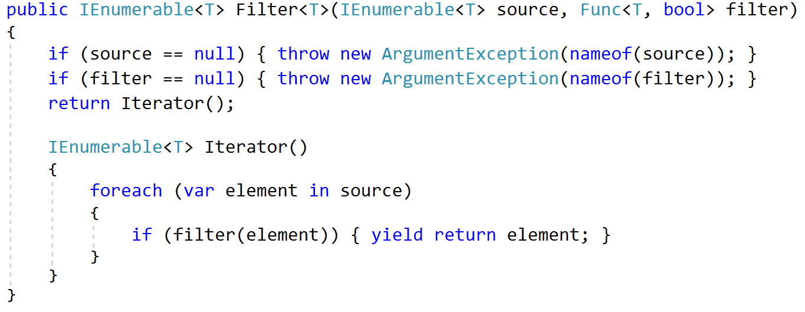
Local Functions
Notes:
Local Functions
https://github.com/dotnet/roslyn/blob/master/docs/features/local-functions.md

Slide 28

IMPLEMENTING
FUNCTIONAL
TECHNIQUES
IN
C#
Notes:
Functional Programming in C#
http://www.codeproject.com/Articles/375166/Functional-programming-in-Csharp
Introduction to Functional Programming in C#
http://www.c-sharpcorner.com/uploadfile/rmcochran/introduction-to-functional-programming-in-C-Sharp/

Slide 29
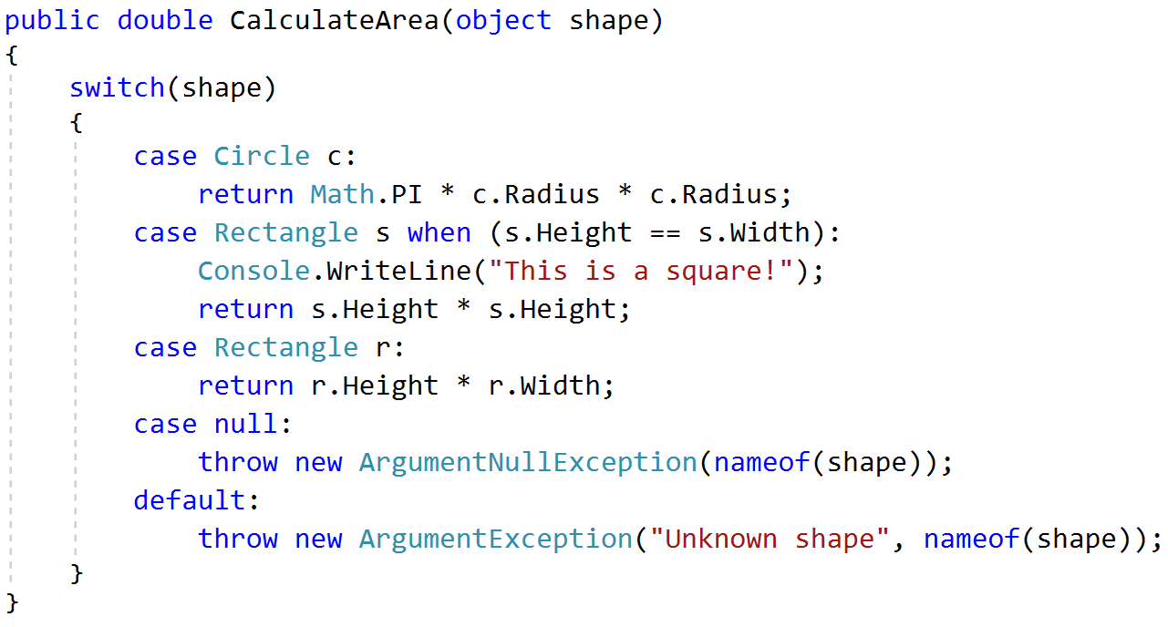
Pattern Matching
Is-expression with pattern
Throw expression
Switch statement with patterns
Notes:
Pattern matching
https://github.com/dotnet/roslyn/blob/master/docs/features/patterns.md
https://docs.microsoft.com/en-us/dotnet/csharp/pattern-matching
Is-expressions with patterns
https://docs.microsoft.com/en-us/dotnet/csharp/language-reference/keywords/is
Switch statements with patterns
https://docs.microsoft.com/en-us/dotnet/csharp/language-reference/keywords/switch
Throw expressions
https://github.com/dotnet/roslyn/blob/master/docs/features/throwexpr.md

Slide 30
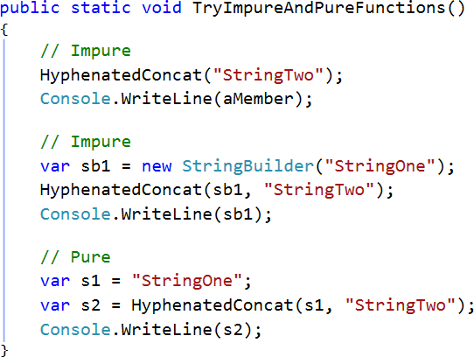
Refactoring into Pure Functions
Notes:
Refactoring Into Pure Functions
https://msdn.microsoft.com/en-us/library/bb669139.aspx
“
One way of transitioning to functional programming is to refactor existing code to eliminate unnecessary side effects and external dependencies. In this way, you can create pure function versions of existing code.
A pure function has two useful characteristics:
It has no side effects. The function does not change any variables or the data of any type outside of the function.
It is consistent. Given the same set of input data, it will always return the same output value.
“

Slide 31
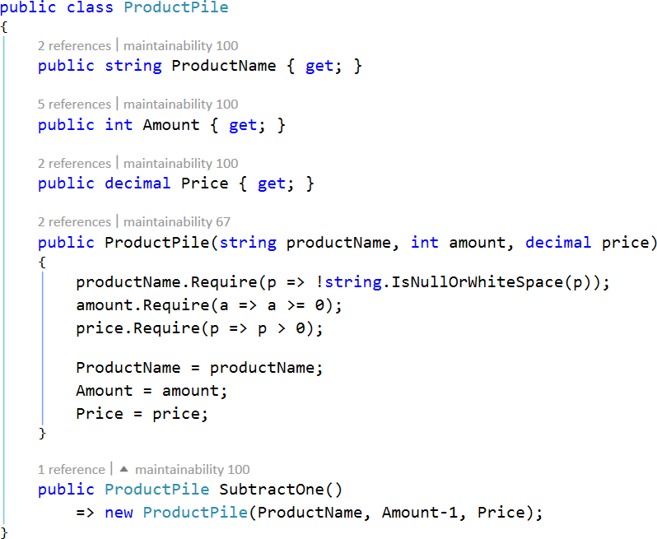
Building Immutable Types
Notes:
To avoid unexpected change of state
Functional C#
http://enterprisecraftsmanship.com/2015/03/02/functional-c-immutability/
Functional C#: Primitive obsession
http://enterprisecraftsmanship.com/2015/03/07/functional-c-primitive-obsession/
Functional C#: Non-nullable reference types
http://enterprisecraftsmanship.com/2015/03/13/functional-c-non-nullable-reference-types/
Functional C#: Handling failures, input errors
http://enterprisecraftsmanship.com/2015/03/20/functional-c-handling-failures-input-errors/

Slide 32
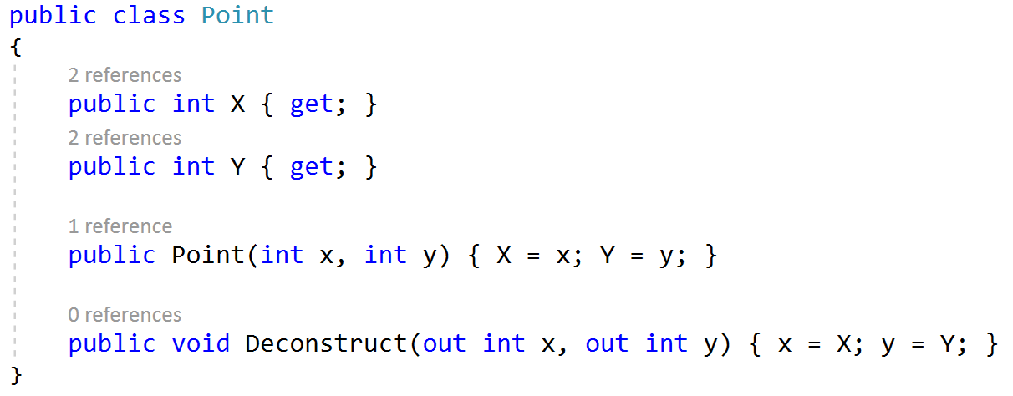
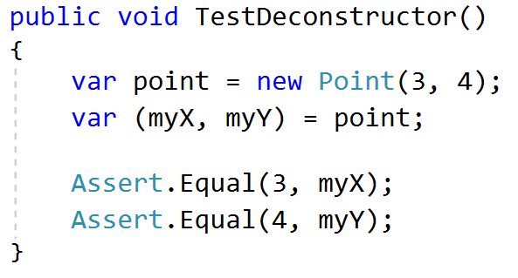
Tuples and Deconstructors
Notes:
Deconstruction
https://github.com/dotnet/roslyn/blob/master/docs/features/deconstruction.md

Slide 33
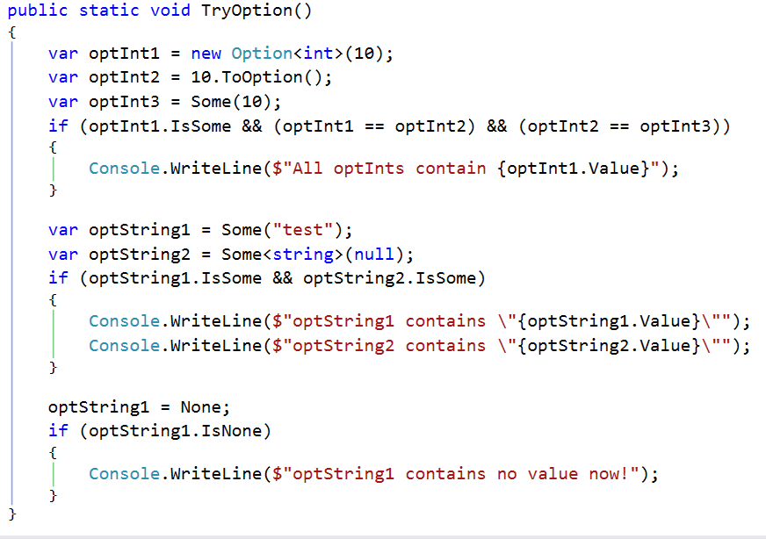
Immutable Types: Options
Notes:
Options (F#)
https://msdn.microsoft.com/en-us/library/dd233245.aspx
“
The option type in F# is used when an actual value might not exist for a named value or variable. An option has an underlying type and can hold a value of that type, or it might not have a value.
“

Slide 34


Recursion with Lambdas
Notes:
Functional Programming in C#
http://www.codeproject.com/Articles/375166/Functional-programming-in-Csharp

Slide 35


Lazy Evaluation
Notes:
Lazy evaluation in C# (yield, Lazy<T>, ThreadLocal<T>, LazyInitializer)
http://www.codeproject.com/Articles/375166/Functional-programming-in-Csharp?msg=4249036#xx4249036xx
“
I've made some C# samples on Lazy evaluation including the features introduced by C# 4 (Lazy, ThreadLocal and LazyInitializer) and the features of C# 3 (yield). “
Lazy<T> Class
https://msdn.microsoft.com/en-us/library/dd642331(v=vs.110).aspx
“
Provides support for lazy initialization.
“

Slide 36


Partial Functions
Notes:
Functional Programming in C#
http://www.codeproject.com/Articles/375166/Functional-programming-in-Csharp

Slide 37

Curry Functions
Notes:
Currying
https://en.wikipedia.org/wiki/Currying
“
In mathematics and computer science, currying is the technique of translating the evaluation of a function that takes multiple arguments (or a tuple of arguments) into evaluating a sequence of functions, each with a single argument.
Uncurrying is the dual transformation to currying, and can be seen as a form of defunctionalization. It takes a function f(x) that returns another function g(y) as a result, and yields a new function f′(x, y) that takes a number of additional parameters and applies them to the function returned by function f. The process can be iterated.
“
Functional Programming in C#
http://www.codeproject.com/Articles/375166/Functional-programming-in-Csharp
“
Currying is a method that enables you to break an N-argument function to N single argument functions (Monads).
“

Slide 38

Uncurry Functions
Notes:
Currying
https://en.wikipedia.org/wiki/Currying
“
In mathematics and computer science, currying is the technique of translating the evaluation of a function that takes multiple arguments (or a tuple of arguments) into evaluating a sequence of functions, each with a single argument.
Uncurrying is the dual transformation to currying, and can be seen as a form of defunctionalization. It takes a function f(x) that returns another function g(y) as a result, and yields a new function f′(x, y) that takes a number of additional parameters and applies them to the function returned by function f. The process can be iterated.
“
Functional Programming in C#
http://www.codeproject.com/Articles/375166/Functional-programming-in-Csharp
“
Currying is a method that enables you to break an N-argument function to N single argument functions (Monads).
You can also use a higher order function to revert the curried function back. In this case, the curried version with several single arguments will be converted back to a multi-argument function
“

Slide 39

Composition
Notes:
Functional Programming with C# - Composition
http://www.c-sharpcorner.com/uploadfile/rmcochran/functional-programming-with-C-Sharp-composition/

Slide 40



Map
Notes:
Equivalent to Select in LINQ

Slide 41


Filter
Notes:
Equivalent to Where in LINQ

Slide 42


Fold Left
Notes:
Equivalent to Aggregate in LinQ

Slide 43

Fold Right
Notes:
LinQ’s Aggregate is a left folding operator
Linq : Folding Left, Right And The LINQ Aggregation Operator
https://dzone.com/articles/linq-folding-left-right-and-th

Slide 44


Memoization
Out variables
Notes:
Memoization
https://en.wikipedia.org/wiki/Memoization
“
In computing, memoization is an optimization technique used primarily to speed up computer programs by storing the results of expensive function calls and returning the cached result when the same inputs occur again. Memoization has also been used in other contexts (and for purposes other than speed gains), such as in simple mutually recursive descent parsing in a general top-down parsing algorithm that accommodates ambiguity and left recursion in polynomial time and space. Although related to caching, memoization refers to a specific case of this optimization, distinguishing it from forms of caching such as buffering or page replacement.
“
Memoization
http://www.dotnetperls.com/memoization
Function Memoization
http://blogs.msdn.com/b/wesdyer/archive/2007/01/26/function-memoization.aspx
Immutable Data and Memoization in C#, Part 1
http://www.jaylee.org/post/2013/04/18/Memoization-and-Immutable-data-in-CSharp-Part-1.aspx
“
The basic idea is that, if the input data is immutable, and that the computation has no side effect, then for a given set of inputs, the output will always be the same. This in turn, means that the result can be cached for later reuse. This is called Referential Transparency.
“
Immutable Data and Memoization in C#, Part 2
http://www.jaylee.org/post/2013/04/22/Immutable-Data-and-Memoization-in-CSharp-Part-2.aspx
If a function is pure, is a candidate for memoization.
Out variables
https://github.com/dotnet/roslyn/blob/master/docs/features/outvar.md

Slide 45

Monads
Notes:
Monad (functional programming)
https://en.wikipedia.org/wiki/Monad_(functional_programming)
“
A monad is a structure that represents computations defined as sequences of steps
“
Monads in C#
http://mikehadlow.blogspot.com.es/2011/01/monads-in-c1-introduction.html
http://mikehadlow.blogspot.co.uk/2011/01/monads-in-c2-whats-point.html
http://mikehadlow.blogspot.co.uk/2011/01/monads-in-c-3-creating-our-first-monad.html
http://mikehadlow.blogspot.co.uk/2011/01/monads-in-c-4-linq-loves-monads.html
http://mikehadlow.blogspot.co.uk/2011/01/monads-in-c-5-maybe.html
http://mikehadlow.blogspot.co.uk/2011/01/monads-in-c-6-introducing-simple-parser.html
http://mikehadlow.blogspot.co.uk/2011/02/monads-in-c-7-turning-our-parser-into.html
http://mikehadlow.blogspot.co.uk/2011/02/monads-in-c-8-video-of-my-ddd9-monad.html
“
C#'s Linq syntax is Monadic
A Monad is a pattern for doing function composition with ‘amplified’ types. You can think of an amplified type as a generic type with a single type parameter. IEnumerable<T> is a very good example.
IEnumerable<T> is in fact a Monad
“
Functional C#: Non-nullable reference types
http://enterprisecraftsmanship.com/2015/03/13/functional-c-non-nullable-reference-types/

Slide 46



Monads & LinQ
Notes:
Monads in C#
http://mikehadlow.blogspot.com.es/2011/01/monads-in-c1-introduction.html
http://mikehadlow.blogspot.co.uk/2011/01/monads-in-c2-whats-point.html
http://mikehadlow.blogspot.co.uk/2011/01/monads-in-c-3-creating-our-first-monad.html
http://mikehadlow.blogspot.co.uk/2011/01/monads-in-c-4-linq-loves-monads.html
http://mikehadlow.blogspot.co.uk/2011/01/monads-in-c-5-maybe.html
http://mikehadlow.blogspot.co.uk/2011/01/monads-in-c-6-introducing-simple-parser.html
http://mikehadlow.blogspot.co.uk/2011/02/monads-in-c-7-turning-our-parser-into.html
http://mikehadlow.blogspot.co.uk/2011/02/monads-in-c-8-video-of-my-ddd9-monad.html
“
C#'s Linq syntax is Monadic
A Monad is a pattern for doing function composition with ‘amplified’ types. You can think of an amplified type as a generic type with a single type parameter. IEnumerable<T> is a very good example.
IEnumerable<T> is in fact a Monad
“

Slide 47


C# & F# Interop
Discriminated Union
F#
Pattern Matching
C#
Notes:
C# to F# Interop – Sharing a Domain Model
http://www.devjoy.com/2013/02/c-to-f-interop-sharing-a-domain-model/
Introduction to F#
http://www.c-sharpcorner.com/uploadfile/rohatash/introduction-to-fsharp/
Discriminated Unions (F#)
https://msdn.microsoft.com/en-us/library/dd233226.aspx
Pattern Matching (F#)
https://msdn.microsoft.com/en-us/library/dd547125.aspx
Main features of F#:
Let the compiler find your bugs
Strong, static types
Generic types
Option types
Discriminated unions + pattern matching
Units of measure
Composable data and functions
Pipelines
Immutable data
Lambda functions
Objects, classes, interfaces, and methods
Async expressions
Computation expressions
Lightweight syntax
Way fewer semicolons and curly braces
Type inference
Shoulders of giants
Type providers
.NET libraries, even when authored in C# or VB
Type providers for using libraries from R and other languages
Fast, iterative workflow
F# Interactive
Script files
Tools + Extensions for Visual Studio, emacs, VSCode, Sublime Text...

Slide 48

LIBRARIES
Notes:
Generalized Algebraic Data Types (GADTs)
Discriminated Unions
Pattern Matching
Object Expressions
Option, List, Memoizer Types
Curry/Uncurry, Partial, Composition, Lazy Functions
Map, Filter, Fold Standard Higher-order Functions
Etc.
Algebraic Data Type
https://en.wikipedia.org/wiki/Algebraic_data_type
“
In computer programming, particularly functional programming and type theory, an algebraic data type is a kind of composite type, i.e. a type formed by combining other types. Two common classes of algebraic type are product types—i.e. tuples and records—and sum types, also called tagged or disjoint unions or variant types.
“
Generalized algebraic data type
https://en.wikipedia.org/wiki/Generalized_algebraic_data_type
“
In functional programming, a generalized algebraic data type (GADT, also first-class phantom type, guarded recursive datatype, or equality-qualified type) is a generalization of the algebraic data types of Haskell and ML, applying to parametric types.
With this extension, the parameters of the return type of a data constructor can be freely chosen when declaring the constructor, while for algebraic data types in Haskell 98, the type parameter of the return value is inferred from data types of parameters; they are currently implemented in the GHC compiler as a non-standard extension, used by, among others, Pugs and Darcs. OCaml supports GADT natively since version 4.00.[4]
“
Discriminated Union
https://en.wikipedia.org/wiki/Discriminated_unión
https://en.wikipedia.org/wiki/Tagged_unión
“
In computer science, a tagged union, also called a variant, variant record, discriminated union, disjoint union, or sum type, is a data structure used to hold a value that could take on several different, but fixed, types. Only one of the types can be in use at any one time, and a tag field explicitly indicates which one is in use. It can be thought of as a type that has several "cases," each of which should be handled correctly when that type is manipulated. Like ordinary unions, tagged unions can save storage by overlapping storage areas for each type, since only one is in use at a time.
Tagged unions are most important in functional languages such as ML and Haskell, where they are called datatypes (see algebraic data type) and the compiler is able to verify that all cases of a tagged union are always handled, avoiding many types of errors. They can, however, be constructed in nearly any language, and are much safer than untagged unions, often simply called unions, which are similar but do not explicitly keep track of which member of the union is currently in use.
Tagged unions are often accompanied by the concept of a type constructor, which is similar but not the same as a constructor for a class. Type constructors produce a tagged union type, given the initial tag type and the corresponding type.
“
Discriminated Unions (F#)
https://msdn.microsoft.com/en-us/library/dd233226.aspx
“
Discriminated unions provide support for values that can be one of a number of named cases, possibly each with different values and types. Discriminated unions are useful for heterogeneous data; data that can have special cases, including valid and error cases; data that varies in type from one instance to another; and as an alternative for small object hierarchies. In addition, recursive discriminated unions are used to represent tree data structures
“
Pattern matching
https://en.wikipedia.org/wiki/Pattern_matching
“
In computer science, pattern matching is the act of checking a given sequence of tokens for the presence of the constituents of some pattern. In contrast to pattern recognition, the match usually has to be exact. The patterns generally have the form of either sequences or tree structures. Uses of pattern matching include outputting the locations (if any) of a pattern within a token sequence, to output some component of the matched pattern, and to substitute the matching pattern with some other token sequence (i.e., search and replace).
Sequence patterns (e.g., a text string) are often described using regular expressions and matched using techniques such as backtracking.
Tree patterns are used in some programming languages as a general tool to process data based on its structure, e.g., Haskell, ML, Scala and the symbolic mathematics language Mathematica have special syntax for expressing tree patterns and a language construct for conditional execution and value retrieval based on it. For simplicity and efficiency reasons, these tree patterns lack some features that are available in regular expressions.
Often it is possible to give alternative patterns that are tried one by one, which yields a powerful conditional programming construct. Pattern matching sometimes include support for guards.
Term rewriting and graph rewriting languages rely on pattern matching for the fundamental way a program evaluates into a result.
“
Pattern Matching (F#)
https://msdn.microsoft.com/en-us/library/dd547125.aspx
“
Patterns are rules for transforming input data. They are used throughout the F# language to compare data with a logical structure or structures, decompose data into constituent parts, or extract information from data in various ways.
“
Object Expressions
https://msdn.microsoft.com/en-us/library/dd233237.aspx
“
An object expression is an expression that creates a new instance of a dynamically created, anonymous object type that is based on an existing base type, interface, or set of interfaces.
You use object expressions when you want to avoid the extra code and overhead that is required to create a new, named type. If you use object expressions to minimize the number of types created in a program, you can reduce the number of lines of code and prevent the unnecessary proliferation of types. Instead of creating many types just to handle specific situations, you can use an object expression that customizes an existing type or provides an appropriate implementation of an interface for the specific case at hand.
“
Options (F#)
https://msdn.microsoft.com/en-us/library/dd233245.aspx
“
The option type in F# is used when an actual value might not exist for a named value or variable. An option has an underlying type and can hold a value of that type, or it might not have a value.
“
Lists (F#)
https://msdn.microsoft.com/en-us/library/dd233224.aspx
“
A list in F# is an ordered, immutable series of elements of the same type.
“
C# is a functional programming language
http://sneezy.cs.nott.ac.uk/fun/nov-06/FunPm.ppt
“
Functional Features not in C#:
Datatypes & pattern matching
Higher-kinded types, existentials, sophisticated modules
Unification/constraint-based type inference
True laziness
GADTs
Generalized Algebraic Data Types permit constructors to return different instantiations of the defined type
Canonical example is well-typed expressions e.g. datatype Expr a with Lit : int → Expr int | PairExpr : Expr a → Expr b → Expr (a £ b) | Fst : Expr (a £ b) → Expr a …
In C#, we can render this using “polymorphic inheritance”: abstract class Expr<a> class Lit : Expr<int> { int val; … } class PairExpr<a,b> : Expr<Pair<a,b>> { Expr<a> e1; Expr<b> e2; … } class Fst<a,b> : Expr<a> { Expr<Pair<a,b>> e; … }
“
Why is C# a functional programmming language?
http://stackoverflow.com/questions/393757/why-is-c-sharp-a-functional-programmming-language
“
This isn't to say that C# is a functional programming language. Its still missing important features such as pattern matching, tail-call optimization, and list literals. Additionally, idiomatic C# is fundamentally imperative with a heavy dependence on mutable state.
“
Why doesn't .NET/C# optimize for tail-call recursion?
http://stackoverflow.com/questions/491376/why-doesnt-net-c-optimize-for-tail-call-recursion
“
Thanks for the suggestion. We've considered emiting tail call instructions at a number of points in the development of the C# compiler. However, there are some subtle issues which have pushed us to avoid this so far: 1) There is actually a non-trivial overhead cost to using the .tail instruction in the CLR (it is not just a jump instruction as tail calls ultimately become in many less strict environments such as functional language runtime environments where tail calls are heavily optimized). 2) There are few real C# methods where it would be legal to emit tail calls (other languages encourage coding patterns which have more tail recursion, and many that rely heavily on tail call optimization actually do global re-writing (such as Continuation Passing transformations) to increase the amount of tail recursion). 3) Partly because of 2), cases where C# methods stack overflow due to deep recursion that should have succeeded are fairly rare.
All that said, we continue to look at this, and we may in a future release of the compiler find some patterns where it makes sense to emit .tail instructions.
“
PortableFCSLib
https://github.com/rmoritz/PortableFCSLib
“
Memoizer Type
Option Type
List Type
Curry/Uncurry Functions
Partial Functions
Composition Functions
Memoization Functions
Lazy Functions
Standard Higher-order Functions
Map, Filter, Fold
“
In LINQ, Map is called Select , Filter is called Where, and Fold is called Aggregate.
Functional C#
http://functionalcsharp.codeplex.com/
“
Pattern Matching
Object Expressions
Discriminated Unions
Monadic Parser
“
functional-utils-csharp
https://code.google.com/archive/p/functional-utils-csharp/
FunctionalSharp
https://github.com/Patrickkk/FunctionalSharp
“
•OptionTypes
•DiscriminatedUnions
•PatternMatching
•PatternMatching & DiscriminatedUnions
“
FunctionalExtensions
https://github.com/webrunners/FunctionalExtensions
“
Option<T>
Choice<T1, T2>
Higher-order functions
Create
ReturnOption
OnExceptionNone
Parsing
Curry
“

Slide 49

System.Collections.Immutable
Notes:
using System.Collections.Immutable;
System.Collections.Immutable Namespace
https://msdn.microsoft.com/en-us/library/system.collections.immutable(v=vs.111).aspx
“
ImmutableArray
ImmutableDictionary
ImmutableHashSet
ImmutableList
ImmutableSortedSet
ImmutableQueue
ImmutableStack
“
Please welcome ImmutableArray<T>
https://blogs.msdn.microsoft.com/dotnet/2013/06/24/please-welcome-immutablearrayt/
Lists (F#)
https://msdn.microsoft.com/en-us/library/dd233224.aspx
“
A list in F# is an ordered, immutable series of elements of the same type.
“

Slide 50

Interactive Extensions
Notes:
using System.Linq;
System.Interactive: Interactive Extensions (Ix) Main Library used to express queries over enumerable sequences
https://www.nuget.org/packages/System.Interactive/
Functional reactive programming
https://en.wikipedia.org/wiki/Functional_reactive_programming
“
Functional reactive programming (FRP) is a programming paradigm for reactive programming (asynchronous dataflow programming) using the building blocks of functional programming (e.g. map, reduce, filter).
“
Reactive-Extensions/Rx.NET
https://github.com/Reactive-Extensions/Rx.NET
“
The Reactive Extensions (Rx) is a library for composing asynchronous and event-based programs using observable sequences and LINQ-style query operators. Using Rx, developers represent asynchronous data streams with Observables, query asynchronous data streams using LINQ operators, and parameterize the concurrency in the asynchronous data streams using Schedulers. Simply put, Rx = Observables + LINQ + Schedulers.
Rx.NET: (this repository) The Reactive Extensions (Rx) is a library for composing asynchronous and event-based programs using observable sequences and LINQ-style query operators.
Ix.NET: (included in this repository) The Interactive Extensions (Ix) is a .NET library which extends LINQ to Objects to provide many of the operators available in Rx but targeted for IEnumerable.
“
Reactive-Extensions/Rx.NET/Ix.NET/Source/
https://github.com/Reactive-Extensions/Rx.NET/tree/master/Ix.NET/Source
ReactiveX
http://reactivex.io/
The Reactive Extensions (Rx)...
https://msdn.microsoft.com/en-us/data/gg577609.aspx
Beginner's Guide to the Reactive Extensions
https://msdn.microsoft.com/en-us/data/gg577611.aspx
Reactive Programming for .NET and C# Developers - An Introduction To IEnumerable, IQueryable, IObservable, and IQbservable
http://www.codeproject.com/Articles/646361/Reactive-Programming-For-NET-And-Csharp-Developers
http://www.amazedsaint.com/2013/08/awesome-libraries-for-c-developers-1.html

Slide 51


C# Functional Language Extensions
Notes:
using LanguageExt;
using LanguageExt.ClassInstances;
using static LanguageExt.Prelude;
LanguageExt.Core
https://www.nuget.org/packages/LanguageExt.Core/
C# Functional Language Extensions
https://github.com/louthy/language-ext
“
Feature -> Description
Lst<T> -> Immutable list
Map<K,V> -> Immutable map
Set<T> -> Immutable set
Que<T> -> Immutable queue
Stck<T> -> Immutable stack
Option<T> -> Option monad that can't be used with null values
OptionUnsafe<T> -> Option monad that can be used with null values
Either<L,R> -> Right/Left choice monad that won't accept null values
EitherUnsafe<L,R> -> Right/Left choice monad that can be used with null values
Try<T> -> Exception catching monad
TryOption<T> -> Option monad with third state 'Fail' that catches exceptions
Reader<E,T> -> Reader monad
Writer<O,T> -> Writer monad
State<S,T> -> State monad
Rws<E,O,S,T> -> Reader/Writer/State monad
Monad transformers -> A higher kinded type (ish)
Process library -> Actor system. The same as Erlang processes for massive concurrency with state management.
Redis persistence -> Persistence of the Process system message-queues and state, for robustness and inter-app communication.
Currying -> https://en.wikipedia.org/wiki/Currying
Partial application -> https://en.wikipedia.org/wiki/Partial_application
Memoization -> https://en.wikipedia.org/wiki/Memoization
Improved lambda type inference -> var add = fun( (int x, int y) => x + y)
IObservable<T> extensions ->
“

Slide 52

AND
FINALLY…

Slide 53


Imperative vs. Functional Style
Notes:
Introduction to Functional Programming in C#
http://www.c-sharpcorner.com/uploadfile/rmcochran/introduction-to-functional-programming-in-C-Sharp/
What are the benefits of functional programming?
http://stackoverflow.com/questions/128057/what-are-the-benefits-of-functional-programming

Slide 54


Books
Notes:
Do you want to know more?
Microsoft Virtual Academy
http://www.microsoftvirtualacademy.com/
C# Fundamentals
Programming in C# Jump Start
Building Blocks: C#
Twenty C# Questions Explained
Pluralsight: Functional Programming with C#
https://www.pluralsight.com/courses/functional-programming-csharp

Slide 55
THE
FAST
FUNCTIONAL
AND THE
C# 7.1
Alejandro Campos Magencio
@alejacma
Technical Evangelist
Notes:
Conclussions
Functional Programming with C# is feasible.
Functions are First-class in C#.
Potential benefits:
Brevity thx to more concise code. Code Reuse.
Less side effects thx to Immutability and Pure Functions. Avoid problems such as null values. Ease of testing.
Efficiency and scalability. Easier to parallelize your code. Good for concurrency.
Performance gains thx to lazy evaluation.
C# gives us freedom of choice: we can use functional programming or not, as C# is a multi-paradigm language.
The future of C# looks functional.
Testing C# code in Windows, Linux or macOS:
Download Visual Studio Code (https://code.visualstudio.com/) with its C# extension (https://marketplace.visualstudio.com/items?itemName=ms-vscode.csharp), and .NET Core 2.0 SDK (https://www.microsoft.com/net/download/core).
More details here:
.NET and C# - Get Started in 10 Minutes (https://www.microsoft.com/net/core)
Unit testing C# in .NET Core using dotnet test and xUnit (https://docs.microsoft.com/en-us/dotnet/core/testing/unit-testing-with-dotnet-test)
Unit testing F# libraries in .NET Core using dotnet test and xUnit (https://docs.microsoft.com/en-us/dotnet/core/testing/unit-testing-fsharp-with-dotnet-test)
Demos
https://github.com/alejacma/dotNetSpain2016

